Slide 1


Current State
The current status
Notes:
My topic is the current status.
Start with general status.
Pics will be shown at the end of the presentation,
otherwise we have dozens of Videos on our
Workadventure Map. Show up and and look around a
bit.

Slide 2

Current State
Yes, still Alpha...
- Many missing parts and TODOs in existing ones
- More than enough bugs left
- Stability is not what to expect from a daily driver
- Real hardware support is still not good enough
Notes:
- Many missing parts and TODOs in existing ones
- More than enough bugs and bugreports left
- Stability is not what to expect from a daily driver
- Real hardware support is still not good enough
Becomes better daily, but still have a long way to go.
Now in more detail.

Slide 3
Current State
… but we are progressing well!
- Many programs and drivers start to work
- Current hardware needs are addressed
- New developers entered the stage
BUT:
- We need every help we can get!
- Patches are welcome!
- Reports from testers are welcome, too!
Notes:
- Many programs and drivers start to work
- Current hardware needs are addressed slowly
- New developers entered the stage
BUT:
- We need every help we can get!
If interested in low level coding in a OS project where you still can dig deep in the internals, welcome!
If not, welcome too!
- Patches are welcome! (Github or Jira)
- Bug/Reports from testers are welcome, too! (Jira)
The reason why we are here today. Tell that to the public.
Now to part 1.

Slide 4
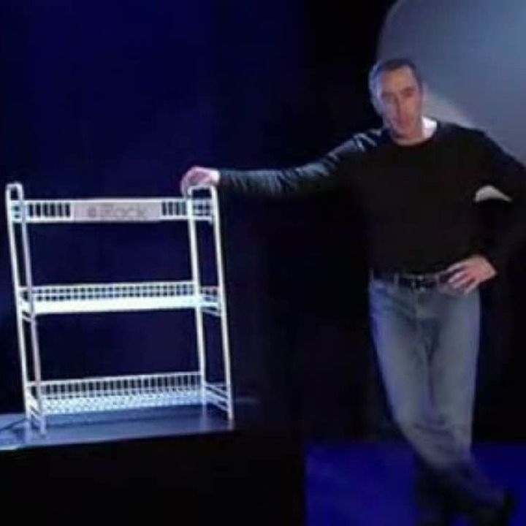
Look & Feel
Classic Windows look is ugly…?
- Theming support quite mature by now
- Many themes included or available in RAPPS
- Microsoft themes for XP/2003 work
Notes:
- Theming support quite mature by now.
- Many themes included in CD Image and way more available in RAPPS.
- Microsoft themes for XP/2003 work Liike Luna from XP.
Pics later

Slide 5

16-Bit Apps
Windows 3.1 Software is worth the effort...
- Utilizing WineVDM by Otya128 (https://github.com/otya128/winevdm)
- Support since 0.4.15-dev-g0f05abe
- Copied in the right folder you just start 16-Bit apps and installers
- Compatibility is VERY HIGH!
- DOS app support comes from our NTVDM
Compatibility is quite high too
Notes:
We already have the DOS subsystem included a while now. It did not run 16 Bit apps for Windows though. Fixed
- Utilizing WineVDM by Otya128 (https://github.com/otya128/winevdm)
- Support since 0.4.15-dev-g0f05abe
- Not indluded yet, but if copied to the correct folder, you can run MANY 16 Bit Windows apps simply by double clicking. Single file apps and Installers are working.
- Compatibility is VERY HIGH!
- DOS app support comes from our NTVDM.
Compatibility is quite high too.
Pics later.

Slide 6
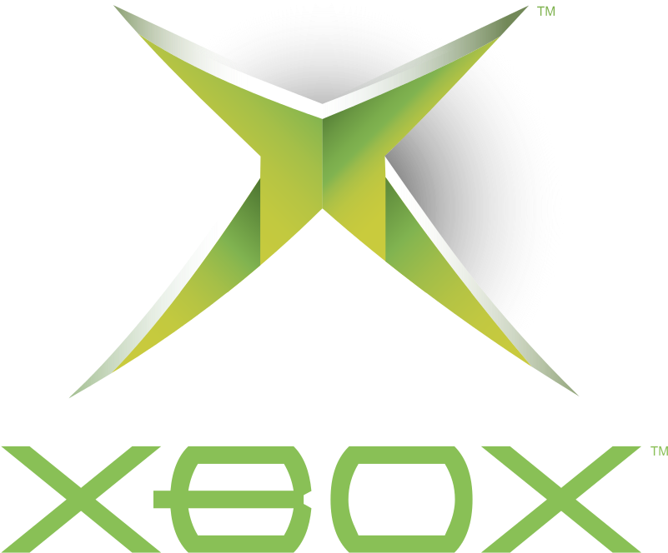
XBOX Port
We talk about the CLASSIC one...
- LiveCD boots when built for -DSARCH=XBOX
Burnt on CD-RW and started by X/Cromwell
Quite stable and proof for the low RAM usage
- BootCD starts, but locks on a black screen...
Notes:
Why? Why not? ^^ It’s a PC hardware and has some interesting special behavior on many components. Adding support for it will cause a general real HW support imrovement too.
Status:
- LiveCD boots when built for -DSARCH=XBOX
Burnt on CD-RW and started by X/Cromwell
Quite stable and proof for the low RAM usage or ROS. Can be even lowered more.
- BootCD starts, but locks on a black screen…
Pics later.

Slide 7
XBOX Port
The Problems...
- Special partition format a reason for BootCD failure
- FATX filesystem not able to hold the naming of a recent ReactOS
Chars and path length is way too limited
Only way around: Other Filesystem
- USB a “special” controller. No USB Device for control working yet
Notes:
Problems are still left to do.
- Special partition format a reason for BootCD failure. More precisely the absence of one. The offsets of the partitions are hard coded in XBOX kernel.
- FATX filesystem not able to hold the naming of a recent ReactOS. Very restricted, Unicode file names are impossible! ANSI was restricted in allowed chars, too.
Chars and path length is way too limited as it can be max 42 chars!
Only way around: Other Filesystem
- USB a “special” controller. No USB Device for control working yet

Slide 8
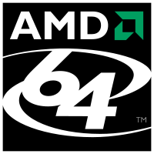
AMD64 Port
About time you showed up...
- Boots!
- Installs!
- Does some stuff!
- Even runs some 3rd party apps!
Notes:
- It boots!
- It installs!
- It even does some stuff!
- It even runs some 3rd party apps!
Pics later.

Slide 9
AMD64 Port
Problems, you might have guessed it...
- Only 64 Bit apps run for now. No WOW64 yet
Installers for 64 Bit apps often are 32 Bit...
- Stability of 32 Bit version not reached yet
Notes:
As you might have guessed already… Here are the current nitpicks.
- Only 64 Bit apps run for now. No WOW64 yet
Installers for 64 Bit apps often are 32 Bit...
- Stability of 32 Bit version not reached yet

Slide 10

Games
The PC is not just for work...
- Compatibility is increasing quickly
Community tested many not too recent games with success!
- Many emulators work fine
- Some not too new Nvidia drivers work fine up to 4K!
Notes:
- Compatibility is increasing quickly
Community tested many not too recent games with success! Pics later.
- Many emulators work fine
Currently supported is OpenGL from GFX drivers. DirectX 9 and older by OGL Wrapper.
- Some not too new Nvidia drivers work fine up to 4K!
Sound progresses nicely too.

Slide 11
Games
What?! No 2022 triple-A titles?!
- Currently used WineD3D starts to become a problem
Not a long term solution
- Replacing it with MS DX9 greatly increases game & driver support
- Real DX needs attention
- Still single core only
Notes:
- Currently used WineD3D OpenGL Wrapper starts to become a problem
Not a long term solution
- Replacing it with MS DX9 greatly increases game & GFX driver support
Yes it even causes some driver to just die in fire. Replacing with the real deal and things are fine.
- Real DX needs attention. More ppl!
- Still single core only. More to that topic later ^^ Justin

Slide 12
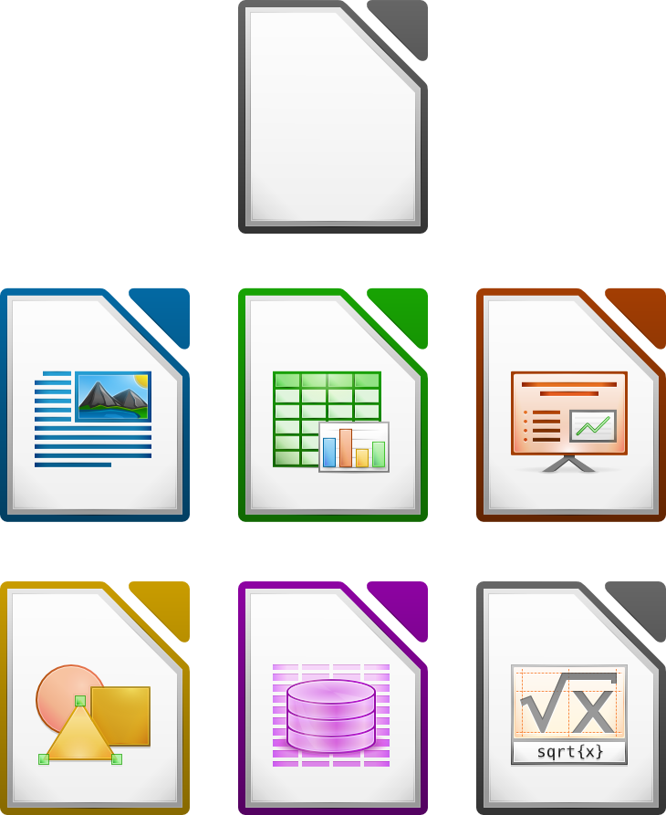
Daily used Software
The stuff you think you need...
- Limited to MS Office </= 2010 or LibreOffice etc.
- Graphics / Animation Software tested with quite some success
- FF >48 are close to finally work. (Hack available)
- Messengers work (ICQ, Telegram, Matrix etc.)
Notes:
- Limited to MS Office </= 2010 or LibreOffice etc.
- Graphics / Animation Software tested with quite some success
- FF >48 are close to finally work. (Hack available)
- Messengers work (ICQ, Telegram, Matrix etc.)
Pics later ^^

Slide 13

Development Software
ReactOS can build itself… sometimes ^^
- GCC/Mingw-w64 works
- MSVC 2005/2008/2010 and sometimes even 2012 works
- Dev-C++ works
- Many more Dev. Environments run, same for compilers!
Notes:
For the crazy ppl out there… Development on ROS? Yes or no?
- GCC/Mingw-w64 works, our own RosBE compiler is a Mingw w64 GCC 8.
- MSVC 2005/2008/2010 and sometimes even 2012 works. Newer… NOT YET
- Dev-C++ works, N++ works
- Many more Dev. Environments run, same for compilers!
Pics follow

Slide 14

Mixed stuff
Sometimes it doesn’t fit anywhere else…
- Microsoft VirtualPC 2012, QEMU, VBOX 2.1 work!
- MS exFAT driver works!
- MS NTFS driver works!
- For the crazy ones… NGINX etc. works!
- Multi Screen support
- Audio support improving!
Notes:
- Microsoft VirtualPC 2012, QEMU, VBOX 2.1 work! So some virtualization works great!
- MS exFAT driver works!
- MS NTFS driver works!
Aka our IFS stack and CC is not too bad by now.
- For the crazy ones… NGINX, httpd etc. works!
- Multi Screen support… works.
- Already mentioned: Audio support improving!

Slide 15
Ich habe fertig!
Notes:
Check time. Slideshow will follow while the Q/A.
Next is Justin with the stuff to come.

